Slide 1
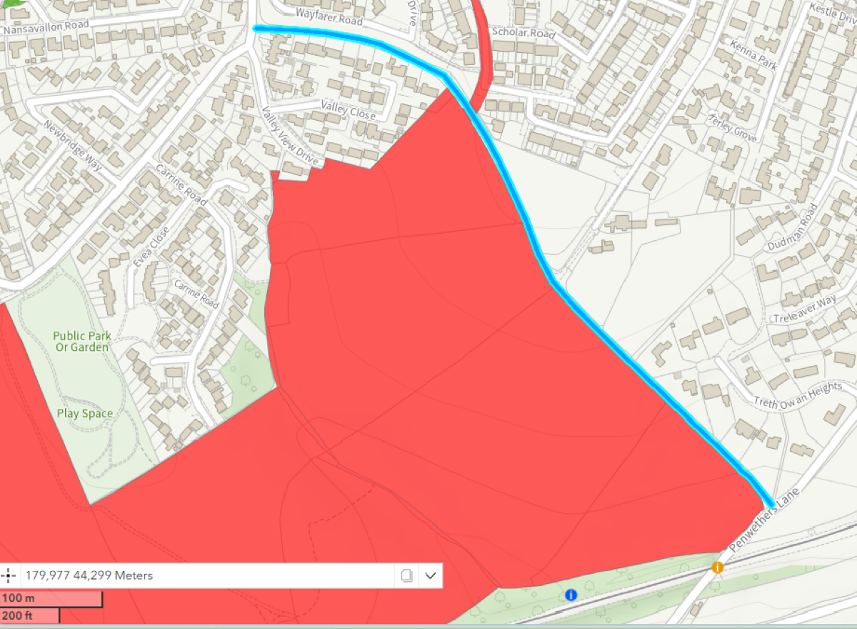
A
C
B
Map for Witness Statement for Application to Confirm Right of Way on ‘Piggy Lane’ (WCA715)
Newbridge Lane
E
Naivgator Way
D
‘Piggy Lane’
Legend
A Council Litter/Dog Waste bin
B Unlocked pedestrian/bike access gate
C Removed byway signs
D Access along byway blocked by Wain Homes September 2025
E Widest points
E
Dudman Farm Development
Wain Homes
Signature:________________
Penwethers Lane
C
C
Date:____________________

